Slide 1

Enviro Scan: Advancing Waste and Pollution Management through Comprehensive Air Pollution Analysis
SRM INSTITUTE OF SCIENCE AND TECHNOLOGY
SCHOOL OF COMPUTING
DEPARTMENT OF COMPUTING TECHNOLOGIES
18CSP109L MAJOR PROJECT
Guide name: Dr. S.S SARANYA
Designation: Assistant Professor Department: C.TECH
Batch ID:CT10B309
Student 1: VAMSI KRISHNA K
Reg. No:RA2011003011160
Student 2 : YASWANTH G V N S
Reg. No:RA2011003011161

Slide 2
ABSTRACT
Enviro Scan represents a paradigm shift in waste and pollution management, focusing on advanced air pollution analysis.
Leveraging cutting-edge technologies and data analytics, Enviro Scan offers real-time monitoring, predictive modeling, and compliance assessment capabilities. Through a systematic approach, it identifies pollution sources, assesses environmental risks, and facilitates proactive intervention strategies.
By integrating comprehensive data analysis with user-friendly interfaces, Enviro Scan empowers stakeholders to make informed decisions, enhancing pollution control measures and safeguarding public health.
This abstract highlights Enviro Scan's potential to revolutionize environmental stewardship, paving the way for a sustainable future with improved air quality and reduced environmental impact.

Slide 3
INTRODUCTION
Enviro Scan emerges as a transformative solution in the realm of waste and pollution management, specifically focusing on comprehensive air pollution analysis. In the face of escalating environmental concerns and the imperative to mitigate pollution's adverse effects, there's an urgent need for innovative approaches.
Enviro Scan addresses this challenge by integrating state-of-the-art technologies and advanced analytical tools to monitor, analyze, and predict air pollution dynamics. By providing real-time insights, proactive intervention strategies, and streamlined compliance processes, Enviro Scan aims to revolutionize how we understand and manage air pollution, ultimately contributing to a cleaner, healthier environment for all.

Slide 4
MOTIVATION
Enviro Scan seeks to address the critical need for effective waste and pollution management by leveraging cutting-edge technology and comprehensive air pollution analysis. With rising concerns over environmental degradation and its impact on public health, there's an urgent demand for innovative solutions.
Enviro Scan aims to fill this gap by providing real-time monitoring, predictive modeling, and streamlined compliance assessment capabilities.
By advancing the understanding of air pollution dynamics and facilitating proactive intervention strategies, Enviro Scan aims to empower stakeholders to safeguard the environment and improve quality of life for present and future generations.

Slide 5
LITERATURE SURVEY
S.No | Title | Author | Year | Inference | Merits | Limitations
1 | Air pollution and human cognition: A systematic review. | Thompson, R., Smith, R. B., Karim, Y. B., Shen | 2023 | Links air pollution to cognitive function decline. | Comprehensive analysis provides strong evidence of the detrimental impact of air pollution on human cognition. | Study scope may not encompass all cognitive aspects affected by air pollution.
2 | Ambient air pollution and clinical dementia: systematic dementia. | Wilker, E. H., Osman, M., & Weisskopf, M. G. | 2023 | Associates ambient air pollution with clinical dementia. | Rigorous systematic review and meta-analysis offer compelling evidence of the relationship between air pollution and clinical dementia. | Potential for publication bias and confounding factors may influence findings.
3 | Air pollution and incidence of dementia: A systematic risk. | Abolhasani, E., Hachinski, V., Ghazaleh, N., Azarpazhoo | 2023 | Establishes a link between air pollution and dementia incidence. | Adds to the growing body of evidence indicating a significant association between air pollution exposure and increased dementia risk. | Heterogeneity in study methodologies and populations may affect result consistency.

Slide 6
LITERATURE SURVEY
S.No | Title | Author | Year | Inference | Merits | Limitations
4 | Analysis of pollutants transport in heavy air pollution. | Chen, M., Chen, Y., Zhu, H., Wang, Y., & Xie, Y. | 2023 | Introduces a complex-network-based model for analyzing pollutants transport in heavy air pollution. | Novel approach enhances understanding of pollutants transport dynamics during heavy air pollution events. | Model validation and generalizability to diverse pollution scenarios require further investigation.
5 | Electricity production, power generation structure, and air pollution. | Zhang, G. X., Yang, Y., Su, B., Nie, Y., & Duan, H. B. | 2023 | Examines the relationship between electricity production, power generation structure, and air pollution. | Offers insights into the impact of electricity production and power generation structure on air pollution levels in Chinese cities. | Limited to analysis within the context of China, may not be fully applicable to other regions with different energy profiles. Data limited to a specific timeframe (2015–2019) may not capture long-term trends accurately.

Slide 7
AIM
Database Management: The project aims to implement a robust database management system. This system will store structured and unstructured data related to waste management, soil quality assessments, sensor readings, dump collection mapping, and air pollution analysis.
Data Collection and Integration: The project seeks to develop mechanisms for data collection from various sources. It will implement data ingestion pipelines to process incoming data streams and integrate them into the database.
Waste Disposal and Treatment: The project will create an effective management system for the disposal and treatment of waste items that have been collected and sorted. This includes discovering and managing trash disposal sites and the processes involved in the treatment of trash.

Slide 8
EXISTING METHOD | PROPOSED METHOD
Database Management: Current system stores data. Data Collection and Integration: Existing system collects and integrates data. Business Logic and Processing: Current system uses algorithms for tasks. System Architecture: Existing system has a certain architecture. Drawbacks: Limited capacity and slower access times. Limited variety of data types can be handled. May struggle with increased complexity and scalability requirements. | Database Management: More robust system. Data Collection and Integration: Improved mechanisms. Business Logic and Processing: Advanced algorithms and machine learning. System Architecture: Modern architecture. Advantages: Can handle larger volumes of data and provide faster access times. More efficient and capable of handling a wider variety of data types. Improved accuracy and efficiency of tasks.

Slide 9
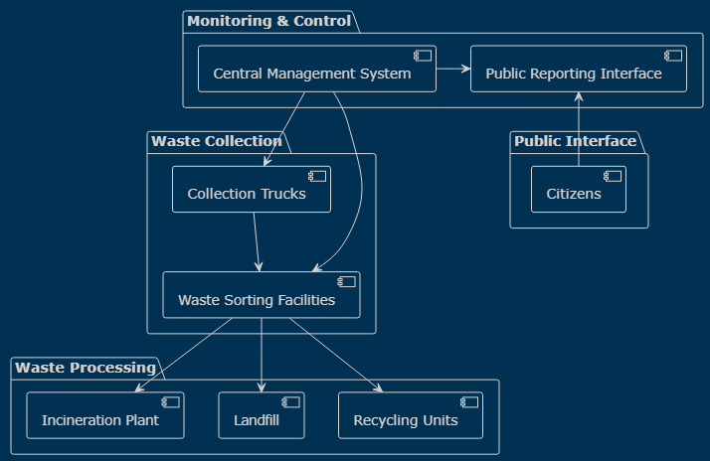
ARCHITECTURE DIAGRAM

Slide 10
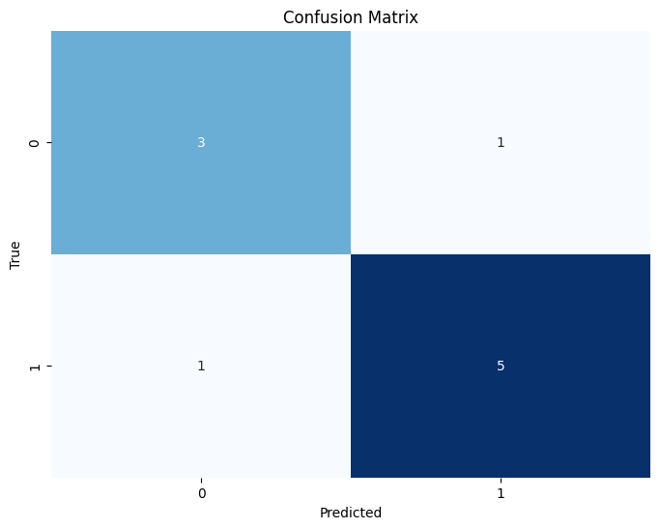
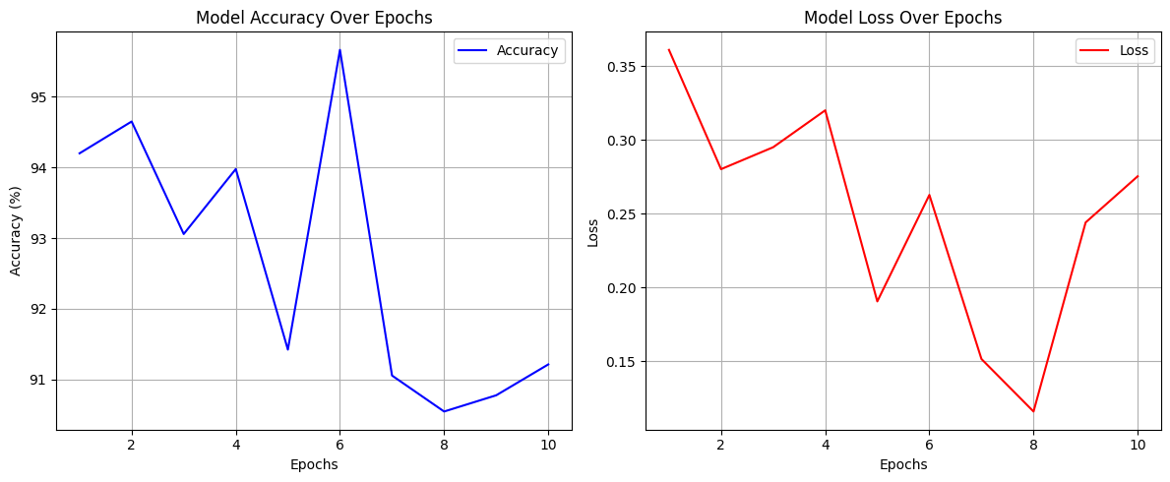
RESULTS AND DISCUSSION
Confusion Matrix Accuracy Loss Graph

Slide 11
COMPARISON BETWEEN CLASSIFIERS
Accuracy | Precision | Recall | F1 score
96.83 | 97.48 | 96.39 | 96.72

Slide 12
CONCLUSION
Scalability and Future Expansion: The proposed system should be designed with scalability in mind. As waste management needs grow, the system should be able to handle increased data volumes, additional sensors, and more complex algorithms.
Community Engagement and Education: To ensure the success of the waste management system, community engagement is crucial. Educating residents about waste segregation, recycling practices, and the benefits of the system will lead to better participation. Consider workshops, awareness campaigns.
Cost-Benefit Analysis: Evaluate the costs associated with implementing and maintaining the system against the benefits it provides. Factors to consider include initial setup costs, operational expenses, environmental impact, and potential savings in waste disposal and treatment. A well-defined cost-benefit analysis will guide decision-making and resource allocation.

Slide 13
FUTURE SCOPE
Monitoring Air Pollution: Comprehensive analysis of emissions from industrial facilities and transportation.
Keywords: Air Quality, Emissions, Monitoring
Stakeholders and Application: Relevant for environmental agencies, regulatory bodies, industries, and affected communities.
Keywords: Stakeholders, Environmental Monitoring, Regulation
Proactive Strategies: Real-time data, predictive modeling, and compliance assessment for effective pollution management.
Keywords: Predictive Modeling, Compliance Assessment, Decision Support
Community Participation: Engage local communities through awareness campaigns, workshops, and educational programs. Encourage waste reduction, recycling, and responsible disposal practices. Community involvement fosters a sense of ownership and collective responsibility toward environmental sustainability.

Slide 14
REFERENCES
[1] Salehi-Amiri, A., Akbapour, N., Hajiaghaei-Keshteli, M., Gajpal, Y., & Jabbarzadeh, A. (2022). Designing an effective two-stage, sustainable, and IoT based waste management system. Renewable and Sustainable Energy Reviews, 157, 112031.
[2] Wang, C., Qin, J., Qu, C., Ran, X., Liu, C., & Chen, B. (2021). A smart municipal waste management system based on deep-learning and Internet of Things. Waste Management, 135, 20-29.
[3] Khan, S., Anjum, R., Raza, S. T., Bazai, N. A., & Ihtisham, M. (2022). Technologies for municipal solid waste management: Current status, challenges, and future perspectives. Chemosphere, 288, 132403.
[4] Elgie, A. R., Singh, S. J., & Telesford, J. N. (2021). You can't manage what you can't measure: The potential for circularity in Grenada's waste management system. Resources, Conservation and Recycling, 164, 105170.
[5] Sondh, S., Upadhyay, D. S., Patel, S., & Patel, R. N. (2022). A strategic review on Municipal Solid Waste (living solid waste) management system focusing on policies, selection criteria and techniques for waste-to-value. Journal of Cleaner Production, 356, 131908.

Slide 15
[6] Rahman, M. W., Islam, R., Hasan, A., Bithi, N. I., Hasan, M. M., & Rahman, M. M. (2022). Intelligent waste management system using deep learning with IoT. Journal of King Saud University-Computer and Information Sciences, 34(5), 2072-2087.
[7] Attia, Y., Soori, P. K., & Ghaith, F. (2021). Analysis of Households’ E-Waste Awareness, Disposal Behavior, and Estimation of Potential Waste Mobile Phones towards an Effective E-Waste Management System in Dubai. Toxics, 9(10), 236.
[8] Sharma, H. B., Vanapalli, K. R., Samal, B., Cheela, V. S., Dubey, B. K., & Bhattacharya, J. (2021). Circular economy approach in solid waste management system to achieve UN-SDGs: Solutions for post-COVID recovery. Science of The Total Environment, 800, 149605.
[9] Gómez-Sanabria, A., Kiesewetter, G., Klimont, Z., Schoepp, W., & Haberl, H. (2022). Potential for future reductions of global GHG and air pollutants from circular waste management systems. Nature communications, 13(1), 106.
[10] Di Foggia, G., & Beccarello, M. (2021). Designing waste management systems to meet circular economy goals: The Italian case. Sustainable Production and Consumption, 26, 1074-1083.

